Slide 1
SPONSORED AND PROVIDED BY:

Slide 2
Water Damaged Hardwoods
What if you could prevent this?

Slide 3
Water Damaged Hardwoods
Look familiar?

Slide 4
Refrigerator Leak
Don’t let this happen to YOUR floors!

Slide 5
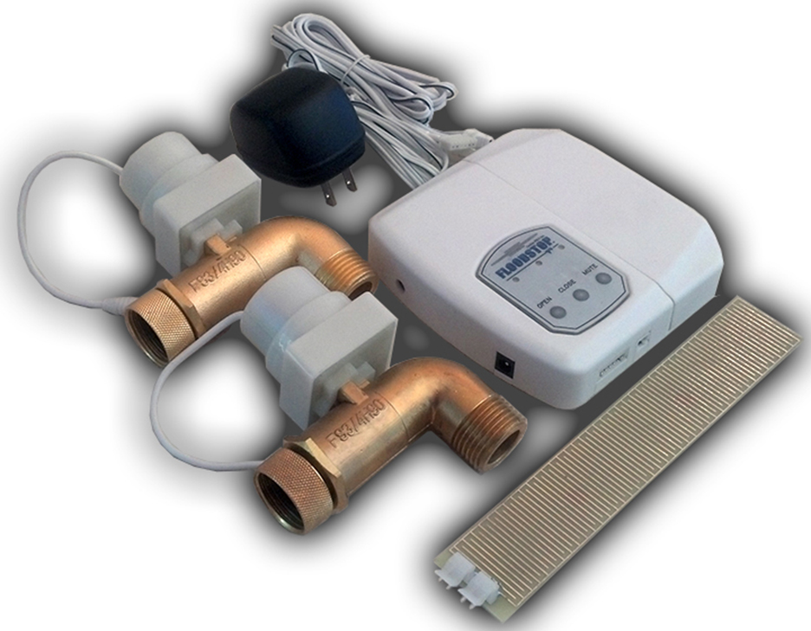
Prevent water damage from flooding and leaking washing machines.
This washing machine leak detector will detect a leak, sound an alarm, and automatically turn off the water supply to the washing machine to prevent any substantial damage..

Slide 6
Water damage caused by leaking washer
This could have been prevented!

Slide 7
Water damage caused by leaking washer
Has this ever happened to you?

Slide 8
This water detection unit can be easily installed in about 10 minutes.
Comes with a One Year warranty.
Four AA batteries as backup or primary power supply
Components: 90 Degree Motorized Ball Valves (Two valves, 3/4 inch Hose Threaded with union), Water/Leak Sensor (1.25” X 7.5”), AC Power Adaptor.

Slide 9
Most Common Issue
This washer hose about to burst!!

Slide 10
More water damaged hardwoods
Expensive repairs $$$$$

Slide 11
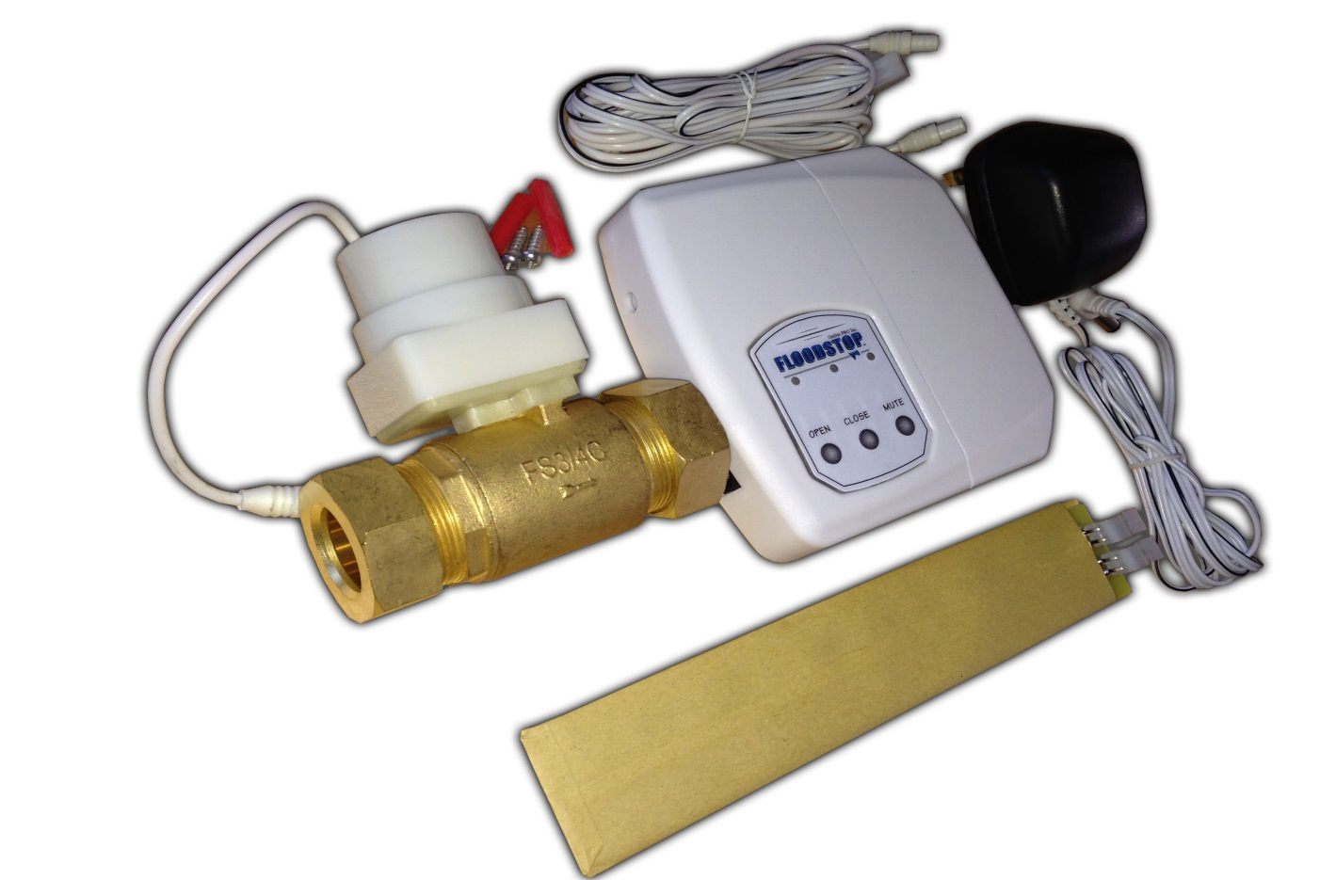
Easily prevent water damage from leaking water heaters, water softeners, or even the water main!
This unit will detect a leak, sound an alarm, and automatically turn off the water supply to the offending appliance or pipe to prevent further damage.
This unit can be easily installed in about 10 minutes.
Comes with a One Year warranty.

Slide 12
Water damage caused by water heater
Has this happened to you or someone you know?

Slide 13
Water heater leak
What about this one?

Slide 14
Busted copper line
How many of you plumbers have seen this?

Slide 15
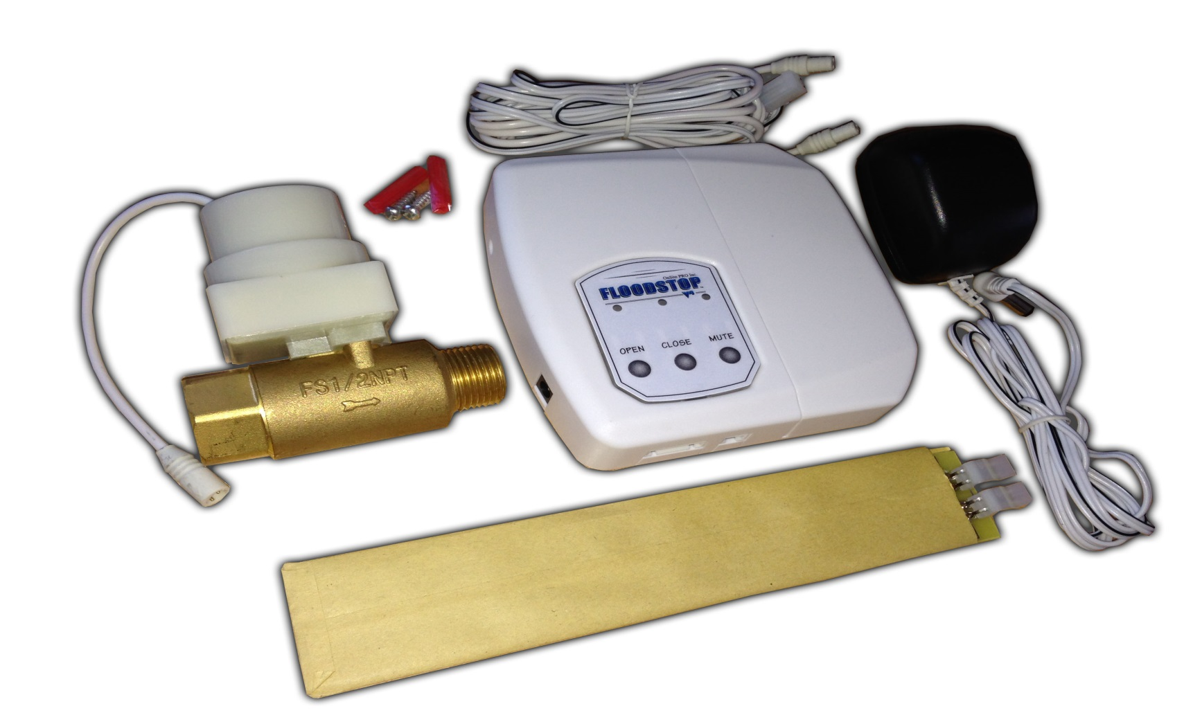
Easily prevent water damage from leaking water filters, ice makers, or any other items that use 1/4" Compression fittings
This unit will detect a leak, sound an alarm, and automatically turn off the water supply to the offending appliance or pipe to prevent further damage.
This unit can be easily installed in about 10 minutes.
Comes with a One Year warranty.

Slide 16
Water damage caused by leaking refrigerator
The leak that has FINALLY shown itself!

Slide 17
Water damage caused by refrigerator
How long has this refrigerator been leaking?

Slide 18
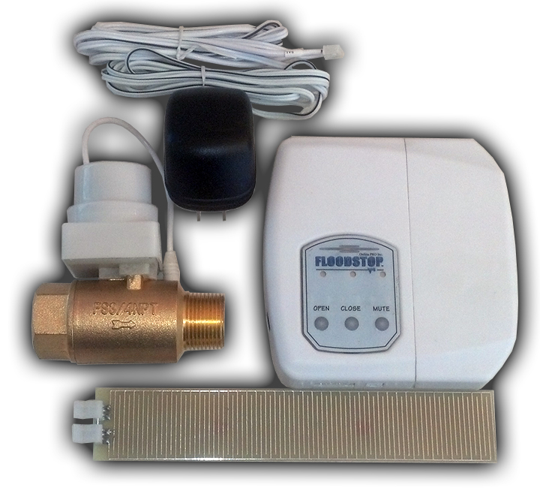
Prevent water damage from flooding Dishwashers, Water Filters, Toilets, or any other items that use 3/8" Compression fittings
This unit will detect a leak, sound an alarm, and automatically turn off the water supply to the offending appliance or pipe to prevent further damage.
This unit can be easily installed in about 10 minutes.
Comes with a One Year warranty.

Slide 19
Water damage caused by Dishwasher
Not a common leak, but what a mess!!

Slide 20
Water damage caused by Dishwasher
Classic dishwasher water damage. Has this ever happened to you?

Slide 21
Call Night Owl Appliance and get FLOODSTOP today!!! 205-739-9988

